Slide 1

Assessing Conditions
Reading: 1.3
exercises: Ch.1: 2, 10, 12, 22, 24, 26
Assigned: hw 3
Producer: dr. mario
img credit: alex riegert-waters

Slide 2
Supplement for Lecture 5
Download Zip Folder on Course Website for Supplement
Unzip Folder and Open the Template.rmd File
Stamp Data
Price = Price of US Stamp (Cents)
Year = Year When Price of Stamp Changed
Question: Can we use a linear regression to understand how the price changes over time?

Slide 3
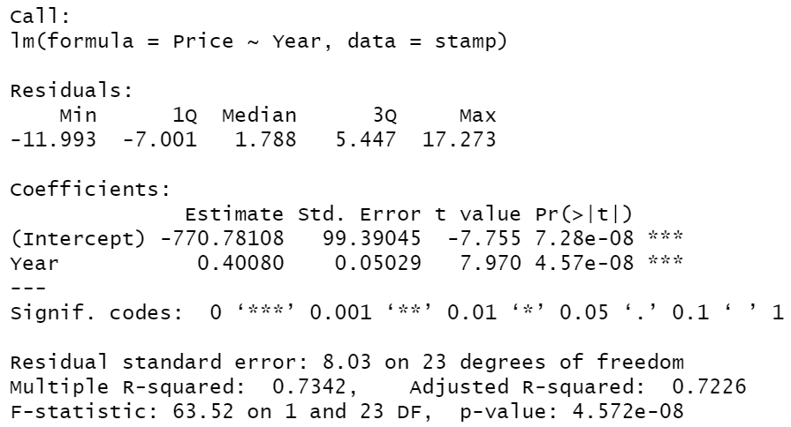
Supplement for Lecture 5
Example Based off Exercise 1.33 from Textbook
Fit Straight Lines to Data With and Without the First Four Years
Output From Summary Function
Estimated Parameters
Residual Standard Error
Degrees of Freedom

Slide 4


Supplement for Lecture 5
Obtaining Fitted Values and Residuals from Models
Saving Fitted Values and Residuals Into Dataset

Slide 5
Residual Versus Fit Plot
Ideal:
Randomly Distributed Around 0 (Independence and Bias)
No Visible Patterns (Fit of Linear Model)
Constant Variance (Heteroscedasticity or Homoscedasticity)
Close to Zero (Good or Bad Fit)
Observe Plots in Supplement for Lecture 5
Remember: Positive Residual = Under Prediction

Slide 6
Residual Versus Order
Only Appropriate if the We Know the Chronological Order of Data
Ideal:
Randomly Distributed Around 0 (Independence and Bias)
No Long Runs Above 0 or Below 0 (Positive Autocorrelation)
No Bouncing Up and Down (Negative Autocorrelation)
Observe Plots in Supplement for Lecture 5

Slide 7
Histogram/Boxplot of Residuals
Ideal:
Bell-shaped and Symmetric (Normal Distributed)
No Gaps (Few Outliers/Influential Points)
Centered Around 0 (Unbiased)
Observe Plots in Supplement for Lecture 5

Slide 8
Normal Plots
Ideal: Pattern is a Perfectly Straight Line (Aligns With Normal Dist.)
Types:
Normal Quantile Plot (Observed Vs Expected Quantiles)
Normal Probability Plot (Observed Vs Cumulative Probability)
Observe Plots in Supplement for Lecture 5

Slide 9
Thank You
Make Reasonable Decisions

